Slide 1


Getting Started with Kubernetes

Slide 2



Slide 3

https://github.com/nigelpoulton/gsk-workshop

Slide 4

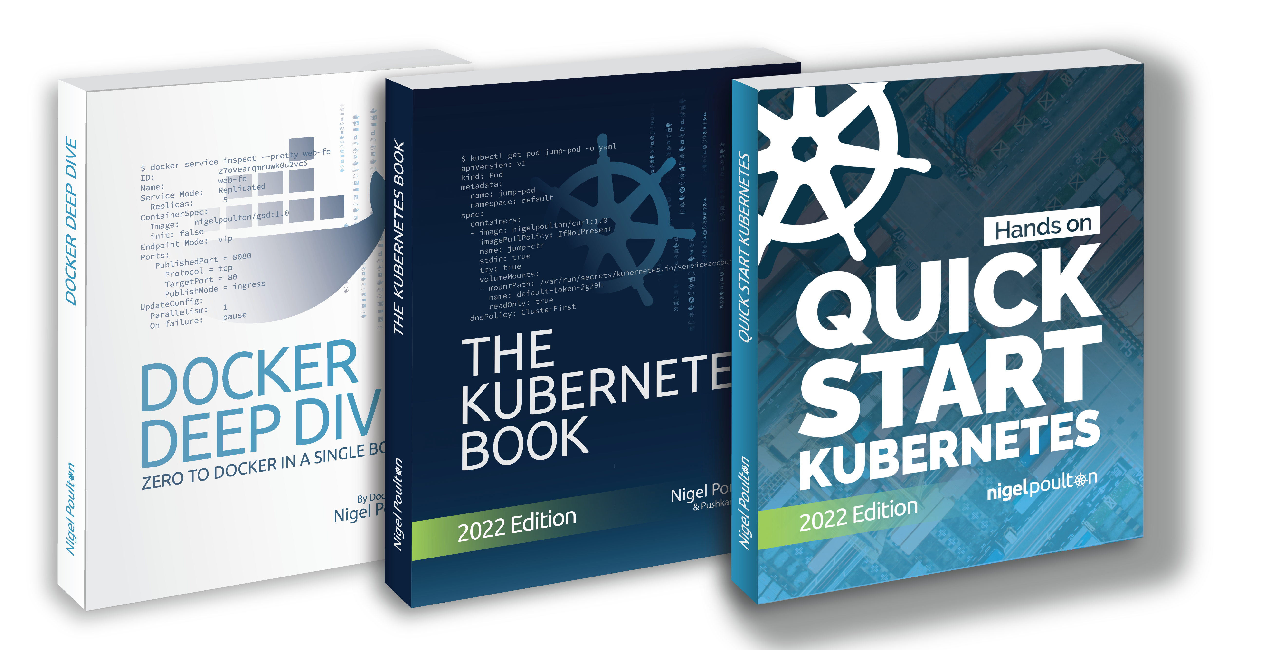

@

Slide 5
Working With Containers
Why Kubernetes
Deploying Apps to Kubernetes
Exposing Apps on Networks
Cloud Native Superpowers
Open Q&A
Agenda

Slide 6

Working With Containers

Slide 7





App
/
/
/
OS (kernel)
PID 0
PID 0
PID 0
Hardware
VM
VM
VM

Slide 8
App
App
App
App
App
App
App
OS
OS
OS
/
/
/
OS (kernel)
PID 0
PID 0
PID 0
Hardware
Container model
Smaller
Faster
Lighter weight
VM
VM
VM
VM model
Better app density

Slide 9

</>
lib x
lib y
Build into container image
Host in a registry
Run in production

Slide 10
Demo

Slide 11
Questions…

Slide 12
Why Kubernetes

Slide 13
Kubernetes
“An orchestrator of microservices applications and the
OS of the cloud”

Slide 14
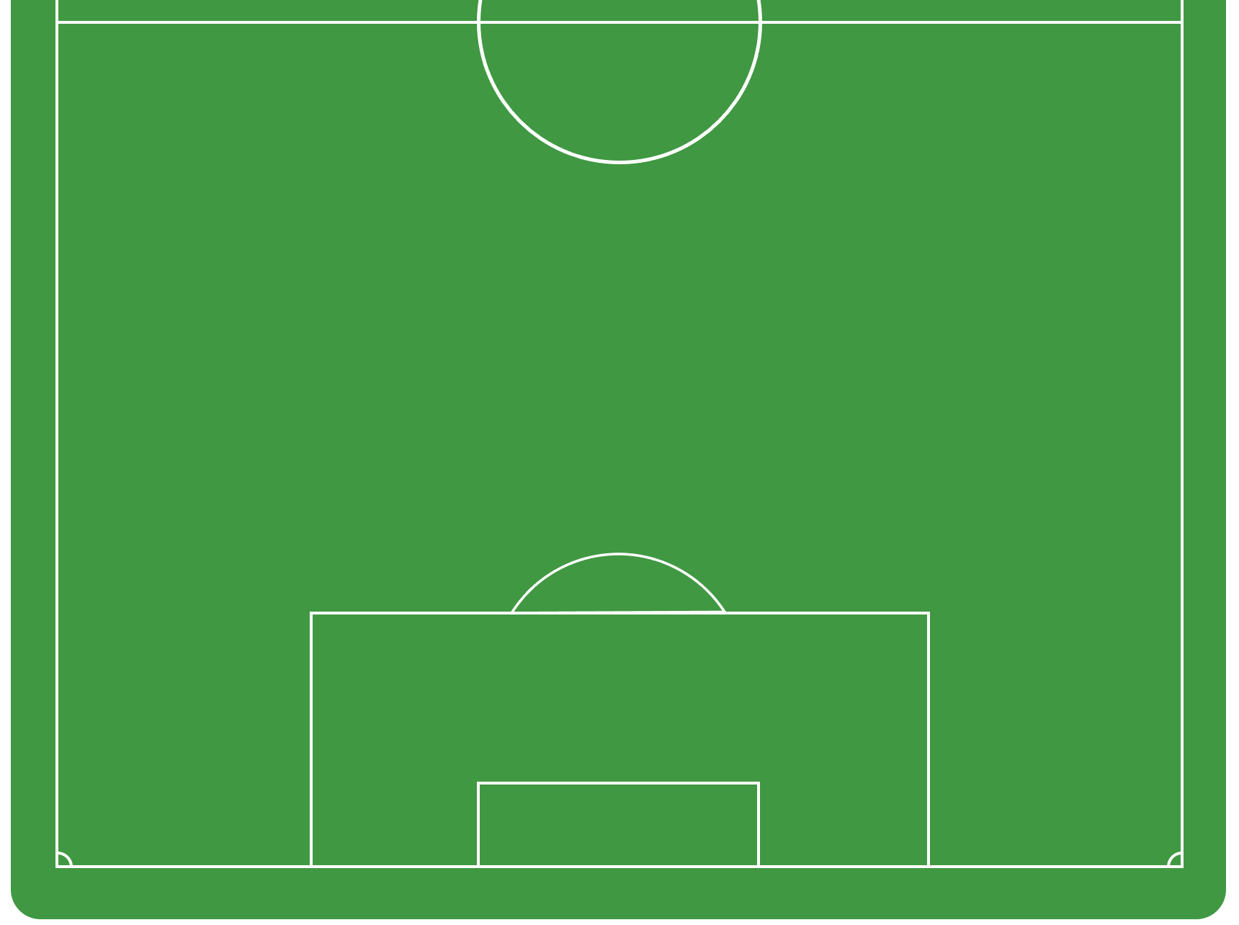



RW
CB
Coach
LB
CM
CM
CB
CF
GK
RB
DM
LW

Slide 15
CF
LW
RW
CM
CM
DM
Coach
LB
RB
CB
CB
GK

Slide 16
CF
LW
RW
CM
CM
DM
Coach
LB
RB
CB
CB
GK

Slide 17
CF
LW
RW
CM
CM
DM
Coach
LB
RB
CB
CB
GK

Slide 18
CF
CF
LW
RW
CM
CM
DM
LB
RB
Coach
CB
GK

Slide 19

db
WWW
WWW
WWW

Slide 20
App
WWW
WWW
WWW
db

Slide 21
App
WWW
WWW
WWW
db

Slide 22
App
WWW
WWW
WWW
db

Slide 23
App
WWW
WWW
WWW
db

Slide 24




App
WWW
WWW
WWW
db
K8s
K8s
K8s
K8s

Slide 25
Questions…

Slide 26
Deploying Apps to Kubernetes

Slide 27

Pod
. . .

Slide 28
Pod
. . .

Slide 29

Pod
xyz
Labels and annotations
Resource limits
Security policies
Restart policies
Probes
Advanced scheduling
<>
><
. . .

Slide 30
Pod
Pod
Pod
Pod
Pod
Pod
Pod
Pod
Pod
VM
VM
VM
VM
VM
Fe
Fe
Fe
Fe
Fe
Kubernetes cluster

Slide 31
Pod
Pod
Pod
Pod
Pod
Pod
Pod
Pod
Pod
VM
VM
VM
VM
VM
Fe
Fe
Fe
Fe
Fe
Kubernetes cluster

Slide 32
App
WWW
db

Slide 33
App
Pod
Pod
Pod
WWW
Pod
Pod
Pod
Pod
Pod
Pod
db

Slide 34
App
Pod
Pod
Pod
Pod
WWW
WWW
Pod
Pod
Pod
Pod
Pod
Pod
db

Slide 35
Demo

Slide 36
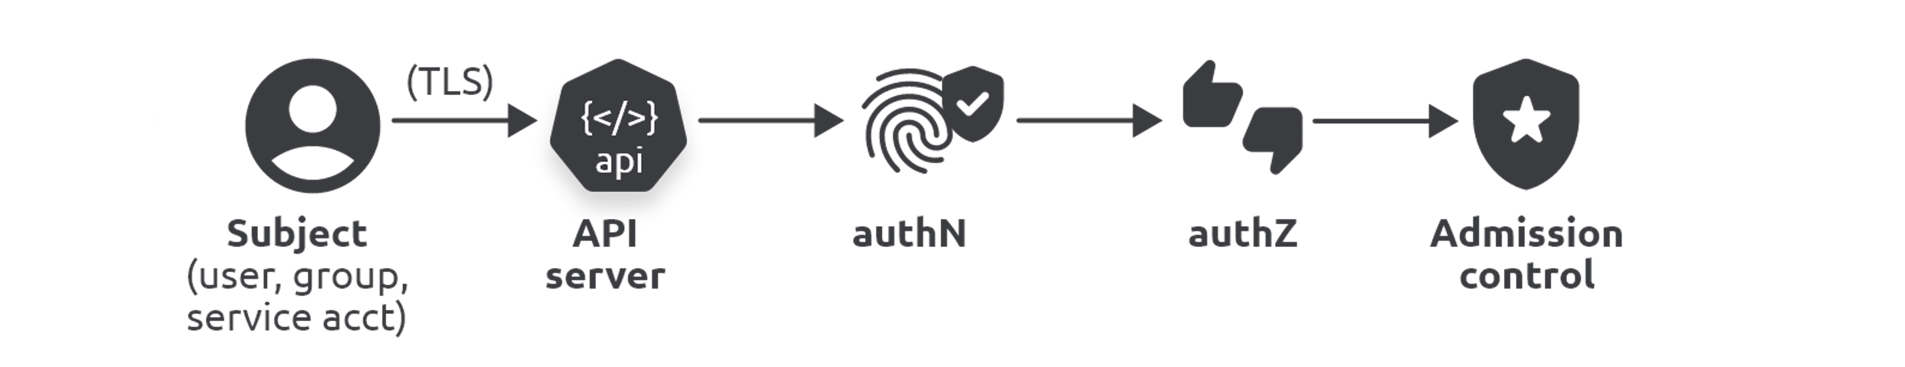
$ kubectl apply -f pod.yml
$ kubectl get pods --watch
$ kubectl describe pod hello-pod

Slide 37
Questions…

Slide 38
Exposing Apps on Networks

Slide 39
Client
¯\_(ツ)_/¯
Pod
Pod
Pod
Pod
Pod
Pod
Pod

Slide 40
Client
Service
Stable name & IP
Label selector: blue Pods
Pod
Pod
Pod
Pod
Pod
Pod
Pod

Slide 41
Client
Service
Stable name & IP
Label selector: blue Pods
Pod
Pod
Pod
Pod
Pod
Pod
Pod

Slide 42
Demo

Slide 43
Client
Cloud LB
Service
Pod
Pod
Pod
Pod

Slide 44
Questions…

Slide 45
Cloud Native Superpowers

Slide 46
Pod

Slide 47
Pod
Scheduling
Resources
Policies
Probes…

Slide 48
Deployment
Pod
Scheduling
Resources
Policies
Probes…
Scaling
Self-healing
…

Slide 49
Demo

Slide 50

$ kubectl
repl
5
Kubernetes

Slide 51
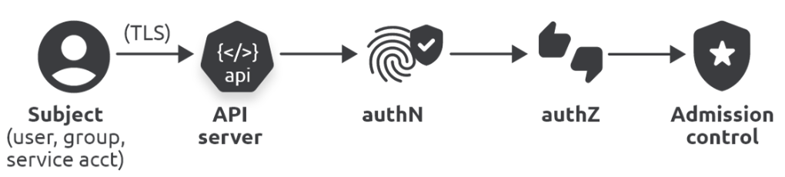
$ kubectl
repl
10
Kubernetes
repl
5
repl
5
Controller
Desired state
Actual state

Slide 52
$ kubectl
Kubernetes
repl
10
repl
5
Controller
Desired state
Actual state

Slide 53
$ kubectl
Kubernetes
repl
10
repl
5
Controller
Desired state
Actual state

Slide 54
$ kubectl
Kubernetes
repl
10
repl
10
repl
5
Controller
Desired state
Actual state

Slide 55
Demo

Slide 56

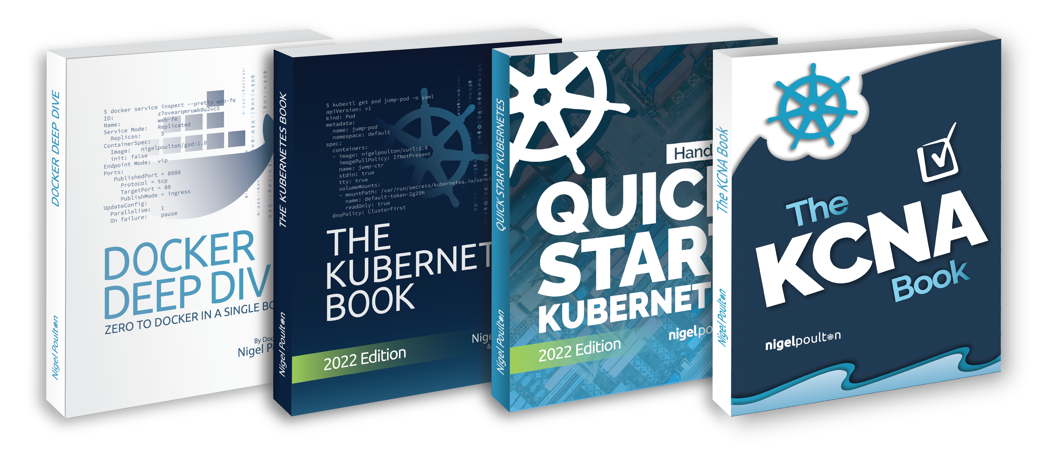
@
Add text/info here
Q&A

